Slide 1
ATM Management System
Java Swing Desktop Application
Student Name: [Your Name]
Course: [Your Course]
Instructor: [Instructor's Name]
Date: [Date]

Slide 2
PROJECT OVERVIEW
Desktop-Based ATM Simulation
This project is a desktop-based ATM simulation system developed using Java Swing. It allows users to securely log in and perform banking operations such as withdraw, deposit, transfer, and check balance.

Slide 3

OBJECTIVES
Simulate real ATM functionality
Implement Object-Oriented Programming
Design GUI using Java Swing
Manage transactions and balance
Store transaction history

Slide 4
TECHNOLOGIES USED
Java
Java Swing
Core programming language
GUI development toolkit
OOP Concepts
ArrayList
Structured code design
Transaction History Management

Slide 5

SYSTEM ARCHITECTURE
Component Interaction
ATMFrame
JFrame controller managing views
ATMSystem
LoginPanel
Main class initializing the app
User authentication interface
DashboardPanel
Main user operations view
This diagram illustrates the hierarchical flow and interaction between the main components of the ATM system, from the entry point to the core business logic.

Slide 6
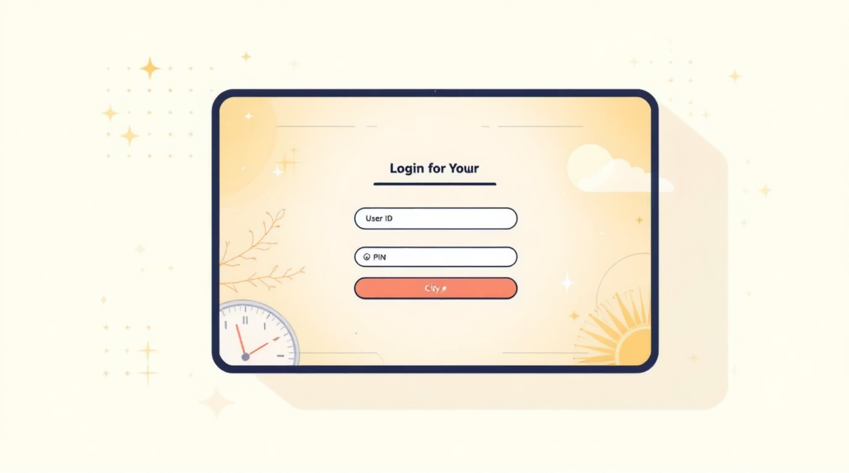
LOGIN SYSTEM
Secure Access (LoginPanel)
Credentials are validated against stored user data to ensure secure access. Incorrect entries trigger appropriate error messages.
User ID field
PIN field
City selection dropdown
Login validation
Error handling

Slide 7

DASHBOARD FEATURES
Banking Operations (DashboardPanel)
Check Balance
Each action on the dashboard directly interacts with the UserAccount class to update balances and record transactions, ensuring real-time data consistency.
Deposit
Withdraw
Transfer
Transaction History
Quit

Slide 8
USERACCOUNT CLASS
Core Business Logic
Attributes:
Methods:
User ID
PIN
Balance
City
Transaction History (ArrayList)
validate()
deposit()
withdraw()
transfer()
getBalance()
getTransactionHistory()
The UserAccount class is central to managing all user-specific data and operations. Every transaction is meticulously recorded in the Transaction History ArrayList for auditing and user review.

Slide 9
KEY FEATURES & OOP CONCEPTS
Key Features:
OOP Concepts:
Secure Login
Encapsulation
Real-time Balance Update
Object Composition
Transaction History Tracking
Event-Driven Programming
Simple Interactive GUI
Separation of UI & Logic

Slide 10
CONCLUSION & FUTURE ENHANCEMENTS
Project Summary
The ATM System demonstrates GUI development, OOP principles, and transaction management using Java Swing.
Future Enhancements:
Database integration
Multiple user accounts
PIN encryption
Admin panel
Thank You – Any Questions?

